Slide 1
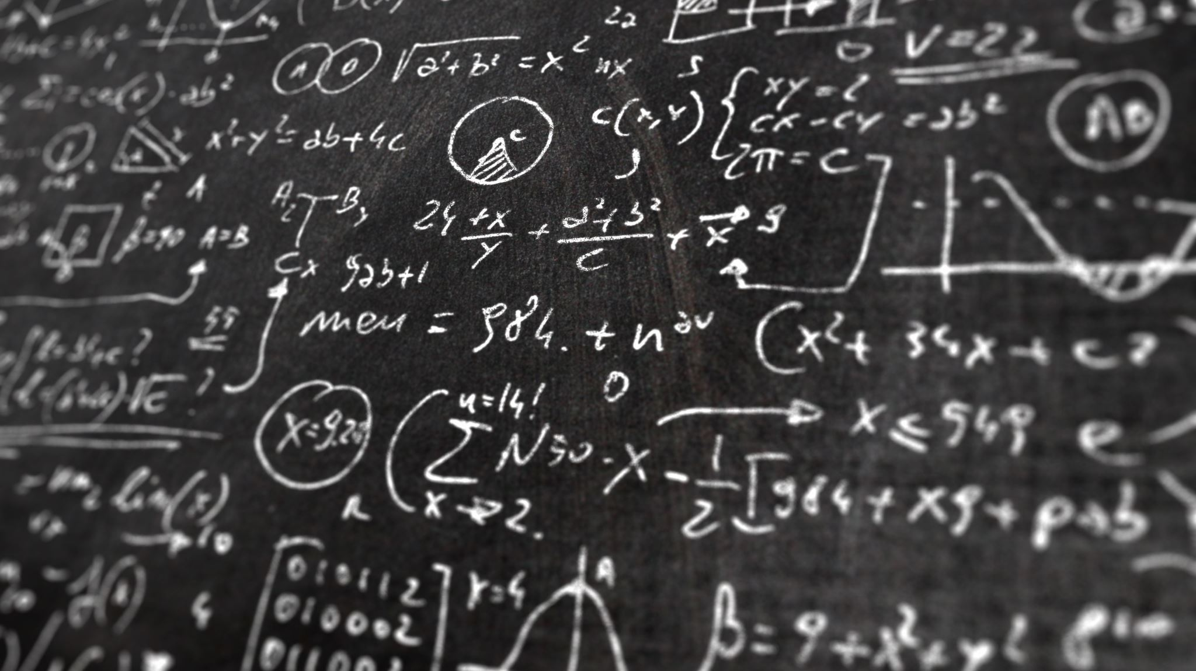
Fractions
Math 1435 Math Fundamentals

Slide 2
Fractions- explanation
A fraction is a part of a whole number. Take 1 piece of a pie that has been divided equally into 8 parts. You now have 1/8th of the pie!
Imperial measurements work the same way. ¾” = (1” equally divided into 4 parts – 3 of those parts represents ¾”)
Some terminology
Numerator – the number on top of the line.
Denominator – the number below the line.
Common denominator – A number in which all of the denominators of a group of fractions will divide evenly.

Slide 3
Adding Fractions
Add the fractions ½ + 3/7
Step 1 -Find a common denominator.
½ and 3/7 have a common denominator of 14 (2x7=14) or (7x2=14).
Step 2 - What you do to the bottom (denominator), you must do to the top (numerator).
1 x 7 = 7 + 3x2 = 6 7 + 6 = 13
2x7 14 7x2 14 14 14 14
What do you do if you have more than 2 fractions?
Add the following fractions; ¼ + 1/2 + 1/7
The common denominator is 28.
1 x 7 = 7 + 1 x 14 = 14 + 1 x 4 = 4
4 x 7 28 2 x 14 28 7 x 4 28
Therefore ; 7/28 + 14/28 + 4/28 = 25/28

Slide 4
Subtracting Fractions
Same rules apply for subtracting fractions as for adding fractions.
First find the lowest common denominator.
Second, do to the numerator what you did to the denominator.
Third, subtract the numerators.
Consider this problem. ½ - 3/7 =
The common denominator will be 14
1 x 7 = 7 - 3 x 2 = 6
2 x 7 14 7 x 2 14
Therefore 7/14 - 6/14 = 1/14

Slide 5
Adding & Subtracting mixed fractions
In order to add or subtract mixed fractions ( 2-3/4). We must first change the mixed fraction into an “Improper fraction”.
Improper fraction – A fraction where the numerator is the same or larger than the denominator.
To change a mixed fraction into an improper fraction, we must first multiply the whole number by the denominator, then add the product to the numerator. 2-3/4 becomes (2 x 4) + 3= 11
4 4

Slide 6
Multiplying Fractions
Multiplying a fraction by a fraction
Multiply the numerators to find its product.
Multiply the denominators to find its product.
Reduce the answer to its lowest terms.
4 x 3 = 12 reduced to; 3 (12/4)
5 x 4 20 5 (20/4)

Slide 7
Multiplying Fractions - example
Cancellation: simplifies the multiplication process by dividing any one denominator and any one numerator evenly by the same number.
Example:
3 x 5 x 1 =
4 6 10
1. The 6 and 3 can be divided by 3 evenly.
1 x 5 x 1 =
4 2 10
2. The 5 and 10 can be divided by 5 evenly.
1 x 1 x 1 = 1
4 2 2 16

Slide 8
Multiplying fractions by a whole number
Multiply a fraction by a whole number
First change the whole number into a improper fraction (2= 2/1).
Change any mixed fractions into improper fractions.
Multiply the numerators to find its product.
Multiply the denominators to find its product.
Reduce the answer to its lowest terms.
Consider this:
3 x ¼ = 3 x 1 = 3
1 x 4 4

Slide 9
Dividing Fractions
The division of fractions requires us to use the reciprocal of a fraction than multiply the inverted fraction by the unchanged fraction.
To invert a fraction, simply exchange the numerator for the denominator in one of the fractions of the problem.
When inverting ½ changes to 2/1, 1/3 changes to 3/1 etc.
Example:
2-3/4 ÷ 1/3
1. All mixed fractions and whole numbers are changed to improper fractions
11 ÷ 1
4 3
2. Change the ÷ sign to a x sign and invert the second number.
11 x 3 = 33
4 1 4
3. Reduce the improper fraction to its lowest terms
33 = 8-1/4
4

Slide 10
Converting Between Decimals and Fractions
Fractions to decimals
Simply divide the numerator (top number) by the denominator (bottom number).
Change 5/8 into a decimal.
5 ÷ 8 = .625
Mixed fraction to a decimal
When dealing with a mixed fraction, the whole number does not change, we divide the numerator of the fraction by the denominator to find the decimal.
Change 2-3/4 into a decimal.
The 2 remains the on the left side of the decimal and the ¾ is changed into a decimal.
2 + (3 ÷ 4) = 2.75

Slide 11
Converting Between fractions and Decimals
Changing from a decimal to a fraction
The key to changing a decimal to a fraction is to understand the columns to the right of the decimal.
.625 – the 6 is in the tenths column, the 2 is in the hundredths column and the 5 is in the thousandths column. Since the last number is in the thousandths column, we simply write the fraction as follows: 625
1000
Now we have to reduce the fraction to its lowest terms.
625 ÷ 25 = 25 = 25 ÷ 5 = 5
1000 ÷ 25 400 400 5 8
Changing from a decimal with whole number to a fraction
The whole number (the number to the left of the decimal) remains a whole number. The decimal is treated as above.
4.625 = 4-5/8

Slide 12
Fractions - Review
Review:
Addition of fractions
Find the common denominator.
Convert fractions to equivalent fractions with the common denominator.
Add the numerators.
Reduce the product to its lowest terms.
Subtraction of fractions
Find the common denominator.
Convert fractions to equivalent fractions with the common denominator.
Subtract the numerators.
Reduce the product to its lowest terms.

Slide 13
Fractions – review page 2
Review:
Multiplication of fractions
Multiply the numerators.
Multiply the denominators.
Reduce the product to its lowest terms.
Division of fractions
Invert the fraction you are dividing by and change the division symbol to a multiplication symbol.
Multiply the numerators.
Multiply the denominators.
Reduce the product to its lowest terms.

